Slide 1

Team Details
Team Name: Cello-fence
Team Leader Name: Diptesh Pradhan
Problem Statement:
Lack of proper storage for high-cost agricultural produce
The use of potassium permanganate in packing materials creates a health hazard
Burning of agricultural waste and residues causing serious environmental pollution

Slide 2

Brief about the idea
The lack of proper storage facilities and inadequate packaging leads to significant post-harvest losses of high-value crops, exacerbated by underutilized cold storage due to unreliable power supply and high infrastructure costs.
Environmental pollution and health concerns are further increased by using potassium permanganate in packing materials, and environmental degradation is further improved by burning agricultural waste.
To address these issues, we propose “ nano-cellu fence," a sustainable and cost-effective nanocellulose-based solution that preserves fruits by maintaining key quality parameters and creating ethylene-free storage environments.
This innovation, produced from agricultural residues, offers a scalable and eco-friendly alternative to current packaging materials, mitigating environmental pollution.

Slide 3
Opportunities
The primary strategy aims to economically and sustainably utilize agricultural waste while ensuring a healthy supply of fruits and vegetables.
By focusing on ethylene scavenging, we utilize agricultural waste materials, such as extracting cellulose from plant residues and formulating it to into nano-cellulose, rather than chemicals.
We are developing a cost-effective nanocellulose-based solution that maintains the essential quality parameters of color, texture, flavor, and nutritional content of preserved fruits during storage.
This includes creating nanocellulose-based coatings for storage containers and transport packaging to provide ethylene-free environments suitable for fruit preservation.

Slide 4
Our approach involves producing cellulose from agricultural plant residues, thereby preventing environmental pollution.
Additionally, we are developing scalable, low-cost nanocellulose-based packaging materials and commercialization strategies, offering a significant alternative to current market packaging materials.
USP
Eco-Friendly and Sustainable
Devoid of Chemical
Commercial Viability
Scalability
Ethylene-free Environment
Quality Preservation
Innovative Solution
Cost Effective

Slide 5
List of features offered by the solution
Eco-Friendly Appeal
Biodegradability
Reduced Carbon Footprint
Low Environmental Impact
Renewable Source
Innovative and Modern
Enhanced Product Freshness
Health and Safety
Potential for Functionalization as antimicrobial activity

Slide 6
Process flow diagram
Biomass Suppliers
(Agricultural Residue)
Pre-treatment Facility
(Extraction of Cellulose)
Nanocellulose Synthesis
Additive Mixing Facility
Film Casting
Logistics and Transport
Packaging Integration Facility
Retail Outlets
End Consumer

Slide 7
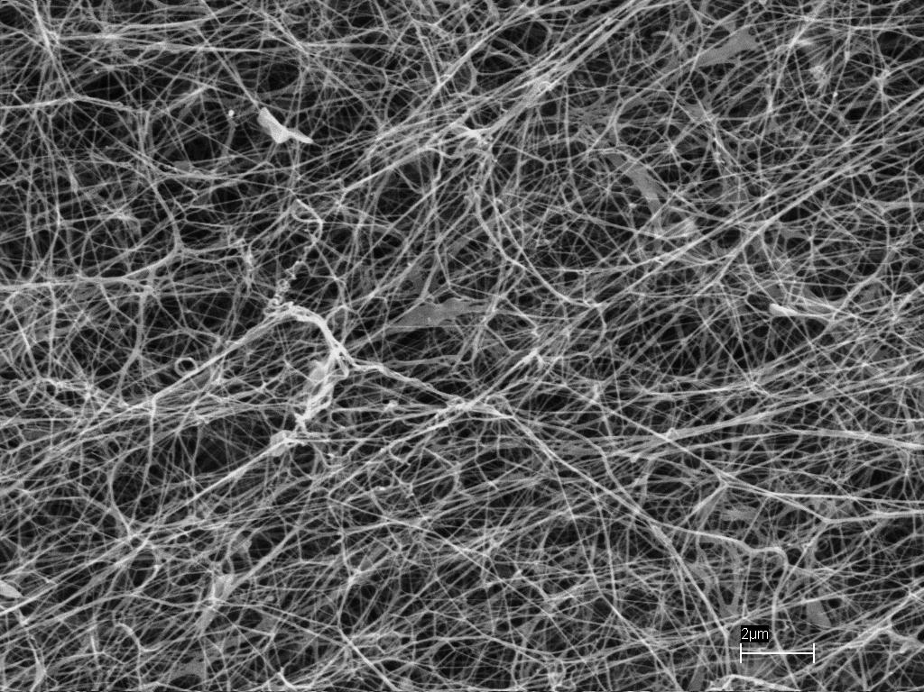
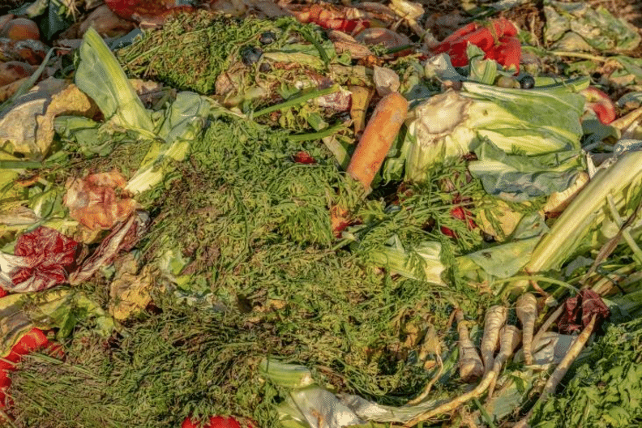
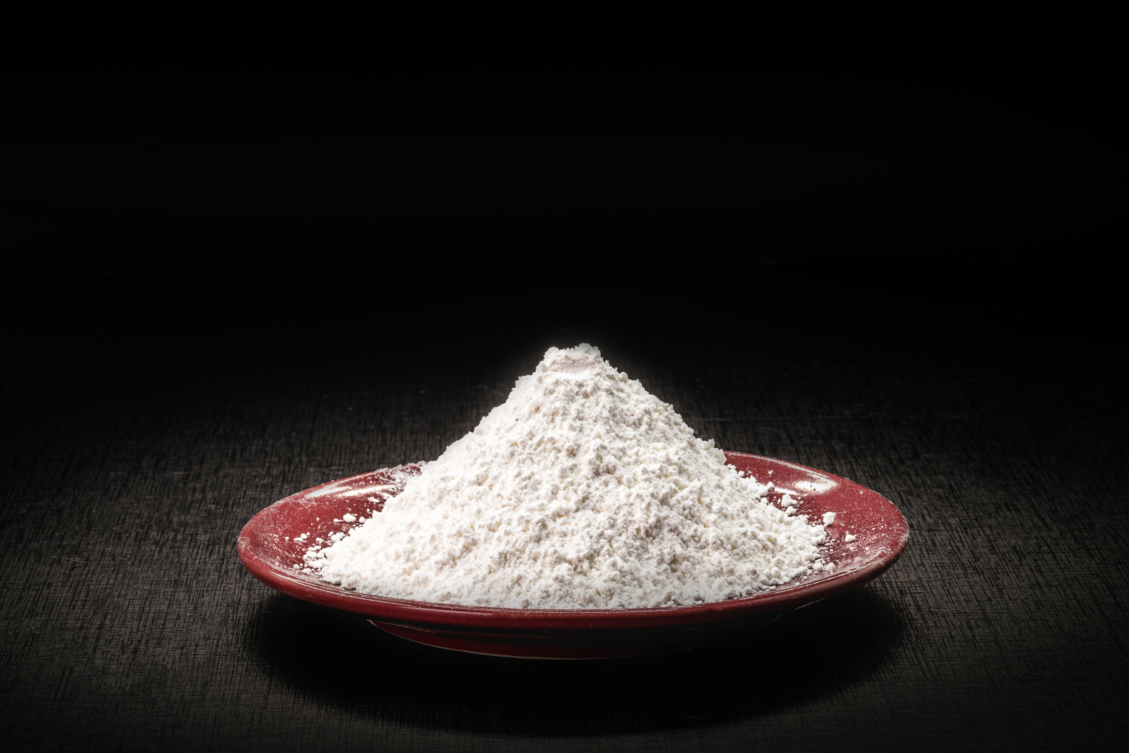
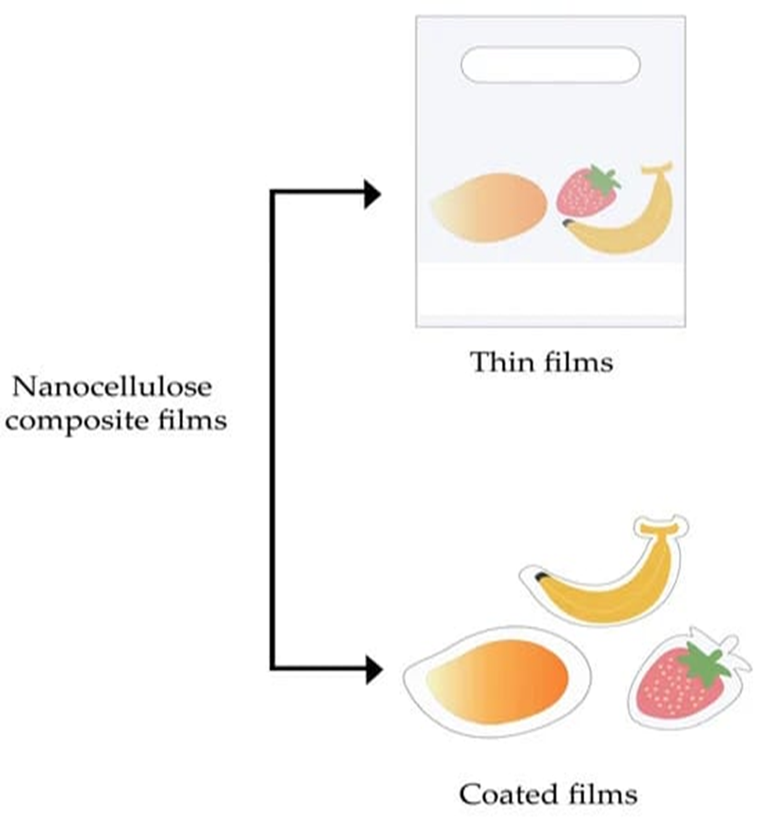
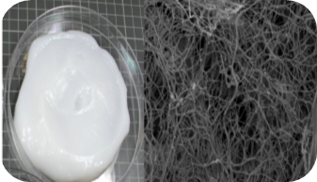
Architecture diagram of the proposed solution
Plant based-cellulose
Agricultural waste
Nano Cellulose
High Pressure Homogenization
Microfluidization
Grinding
Cryocrushing
Ball Milling process
Nanocellulose synthesis methods

Slide 8
Technologies to be used in the solution
Extraction of cellulose from plant residues:
Pre-hydrolysis,
Pulping
Preparation of nano-cellulose:
High-Pressure Homogenization,
Micro fluidization,
Cryocrushing,
Ball Milling process

Slide 9
Estimated Implementation cost
S. No. | Budget Head | Description | Budget Allocation
1. | Capital Expenditure | Centrifuge- for nanocellulose preparation Autoclave- treatment with acid to extract cellulose Stirrer – to get nanosolution | 50,000
2. | Working Capital | Agricultural waste for cellulose extraction, chemicals, glasswares etc. | 50,000
3. | Contingency | Instrument Repair, Spare Parts or Stationery components etc | 10,000
4. | Outsourcing | (Analysis, Characterization, Testing and Certification, Auditing Fees, Startup Incorporation Fees, Financial & Research Consultancy Charges) | 30,000
5. | Marketing & Trials | Third Party Testing and Validation, Customer Outreach and | 50,000
6. | Print and Publications | IP Charges, Trademarks, Copyright | 40,000
Total Amount |  |  | 2,30,000/-

Slide 10
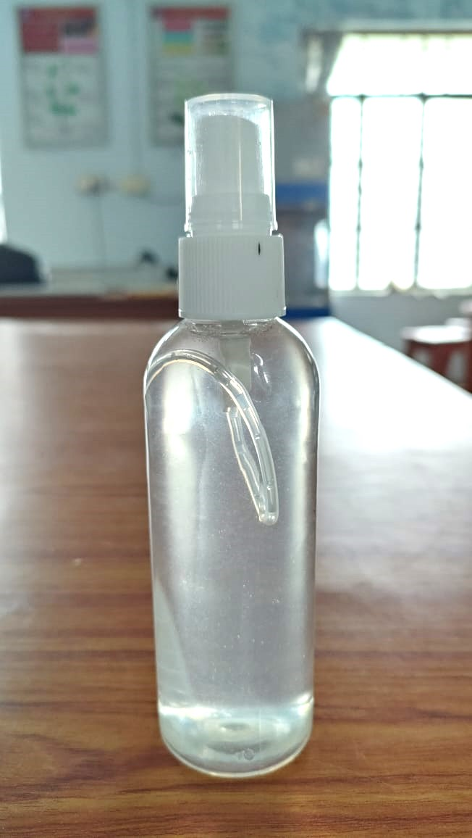
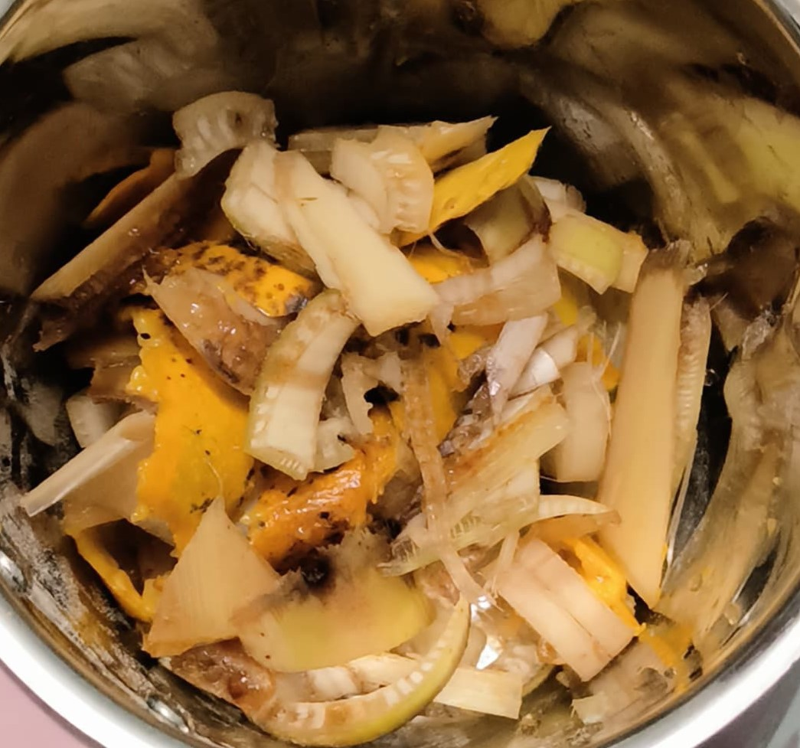
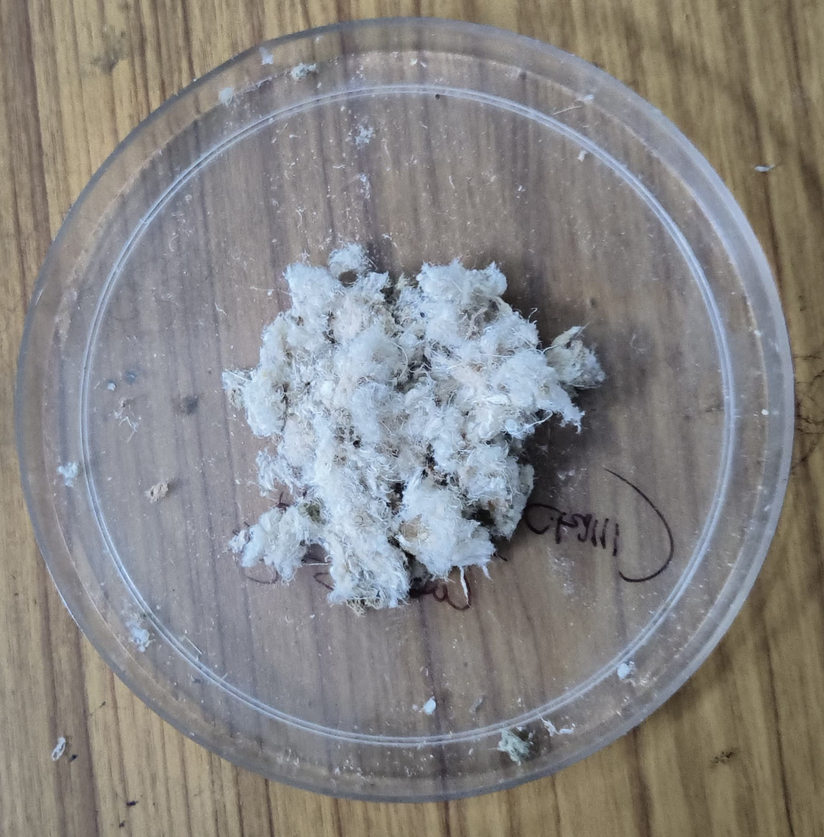
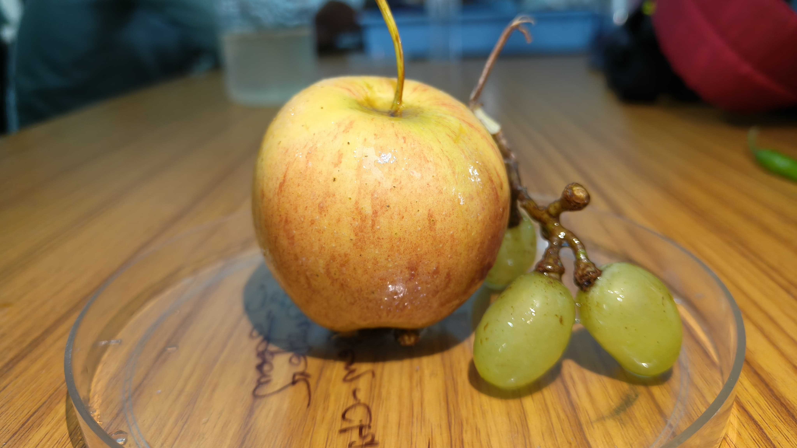
Snapshots of the prototype
Agricultural Waste
Dried Pulp
Nanocellulose Solution
Applied on Fruits

Slide 11
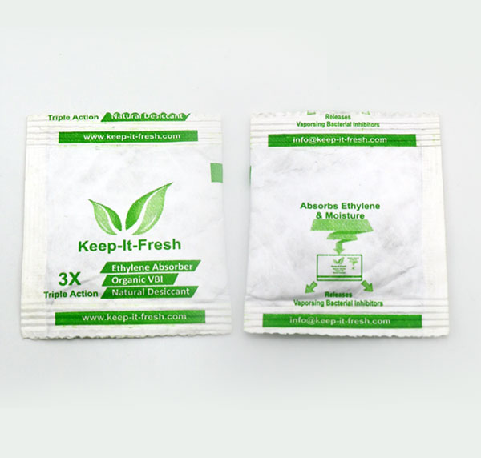
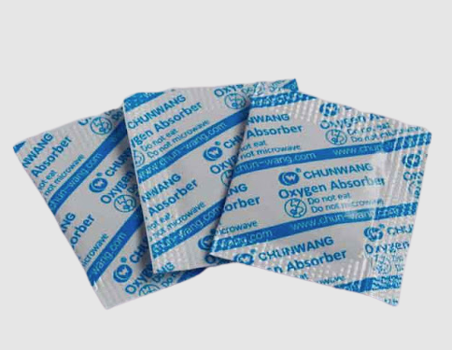
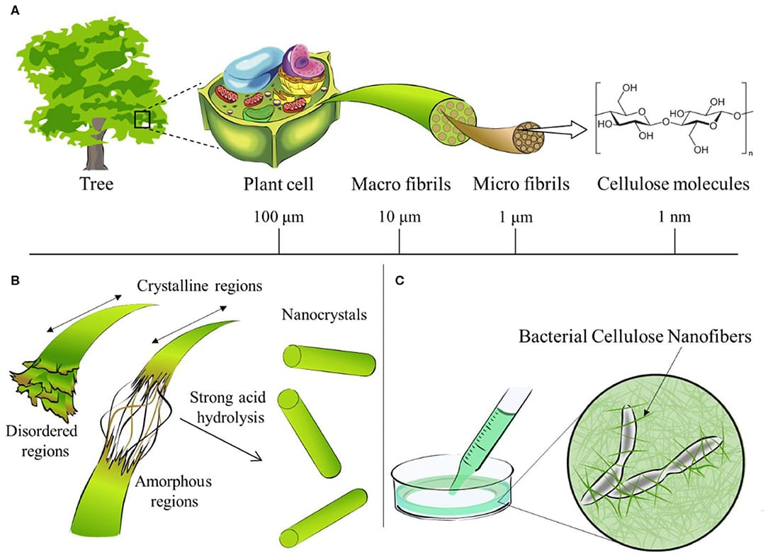
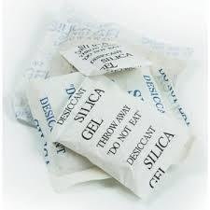
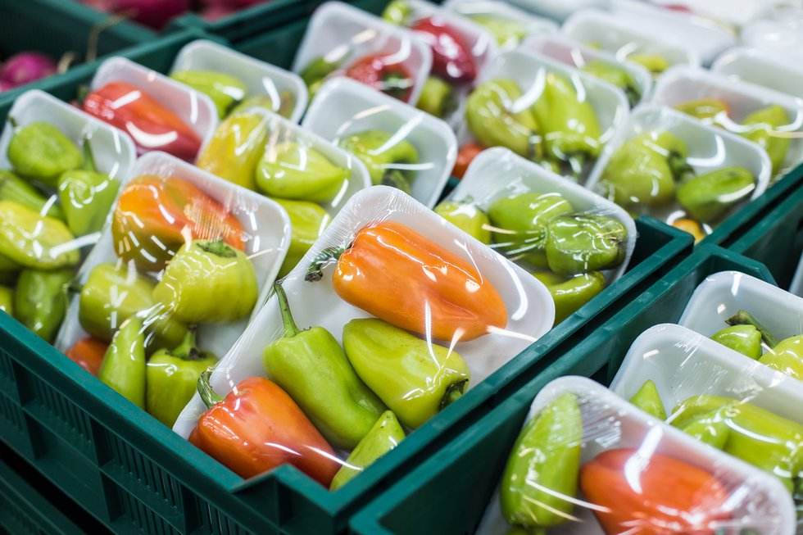
Prototype Performance report
Ethylene Absorber
1. ✖ 2. ✖ 3. ✖ 4. ✖
5. ✖
Oxygen Scavengers
1. ✔ 2. ✔ 3. ✔
4. ✖ 5. ✔
Value Proposition
Promotes sustainable consumption
Enhanced Safety
Biodegradable & eco-friendly solutions
Moisture resistance
Antioxidant Property
Antimicrobial Packaging
1. ✔ 2.✔ 3. ✔ 4. ✔
5. ✔
Moisture Scavenger
1. ✖ 2. ✖ 3. ✖
4. ✔ 5. ✔

Slide 12
Additional Details/Future Developments
3rd month
Procurement of raw materials
6th month
Extraction of cellulose
9th month
Preparation of nano cellulose solution
12th month
Evaluation, testing and finalisation of product

Slide 13
References
Ling Zhou, Hui He, Can Jiang, Li Ma and Peng Y. Cellulose nanocrystals from cotton stalk for reinforcement of poly(vinyl alcohol) composites. Cellulose Chem. Technol., 51 (1-2), 109-119(2017)
Sandeep S. Ahankari, Aditya R. Subhedar, Swarnim S. Bhadauria, Alain Dufresne, Nanocellulose in food packaging: A review, Carbohydrate Polymers, 2021, Volume 255, https://doi.org/10.1016/j.carbpol.2020.117479.
Xiaotong Wang, Jing Guo, Hongyi Ren, Jing Jin, Hui He, Peng Jin, Zhengguo Wu, Yonghua Zheng, Research progress of nanocellulose-based food packaging, Trends in Food Science & Technology, 2024, Volume 143, https://doi.org/10.1016/j.tifs.2023.104289.
M. Asad et al.Preparation and characterization of nanocomposite films from oil palm pulp nanocellulose/poly (Vinyl alcohol) by casting method Carbohydrate Polymers (2018)

Slide 14
GitHub Public Repository Link:
https://github.com/Diptesh-7/Cello-Fence.git
Demo Video Link:
VIDEO LINK https://github.com/user-attachments/assets/dc780081-f673-4a37-b23b-177bb49d9a3a

Slide 15
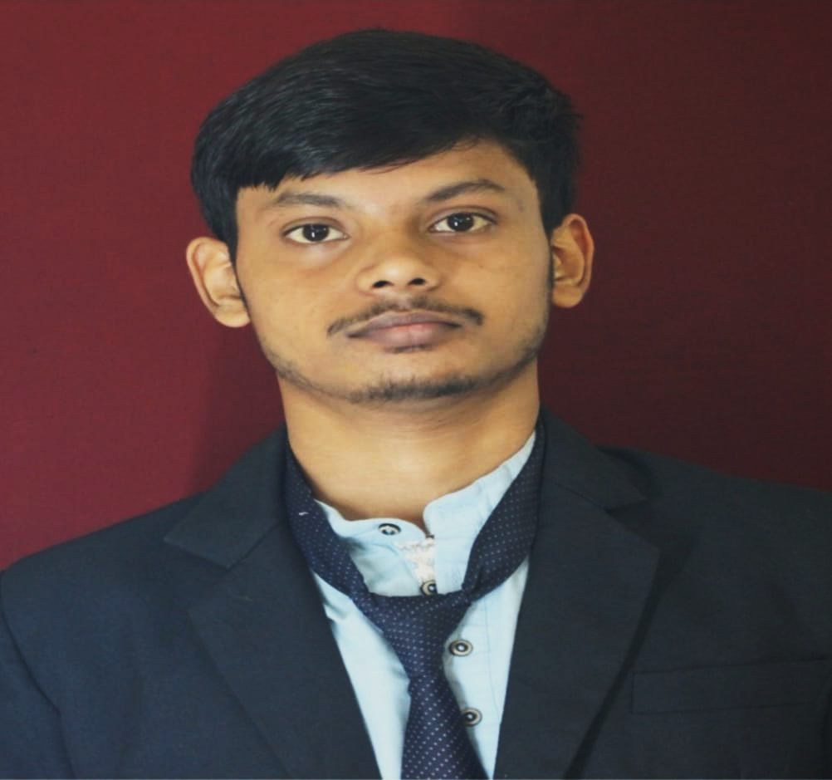
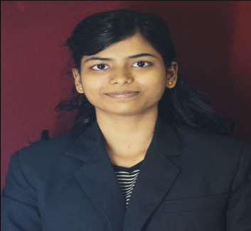
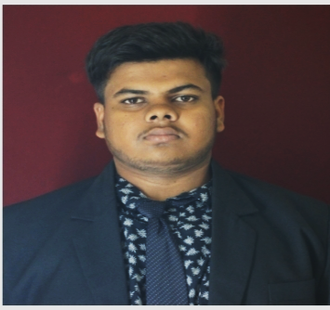
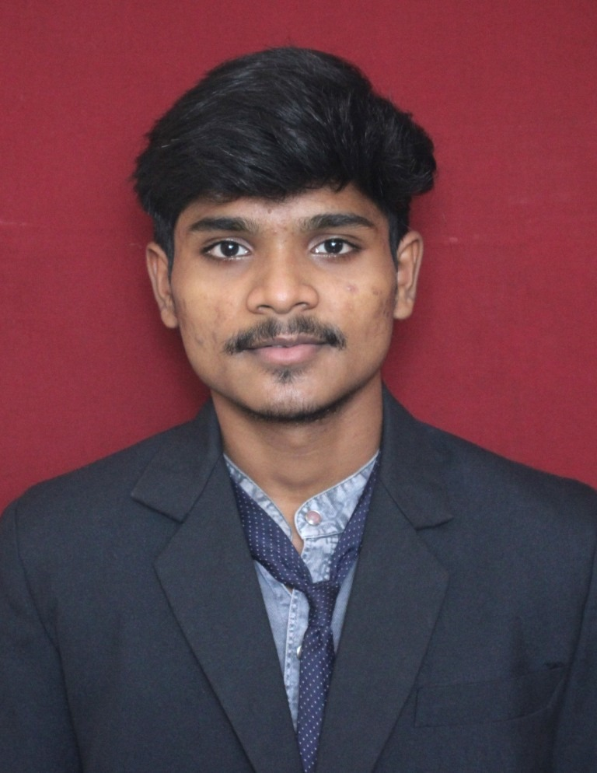
Diptesh Pradhan
Team Leader
Sneha Patra
Arin Ku. Patel
Ashis Ku. Mohanty
B.Sc. Agriculture 3rd Year 5th Semester, School Of Agriculture, GIET University, Gunupur
Dr. Mamata Behera (Mentor)
(Asst. Prof.), Department of Plant Breeding and genetics, School of Agriculture, GIET University, Gunupur.

Slide 16


